Slide 1

IAIA Project 2024-2
IAIA Project #2
Gomoku & Checkers Game Automation
Using UR5e Robot Arm
School of Mechanical & Control Engineering Course: Industrial AI and Automation
Kwak, Jin(21900031)
An, Gyeonheal(21900416)
Lim, Soonho(21900610)
Han, Taegeon(21900793)
Advisor: Prof. Young-Keun Kim
2024.12.10

Slide 2
Contents
Introduction
Gomoku Game
Checker Game
Demo Video
Conclusion

Slide 3
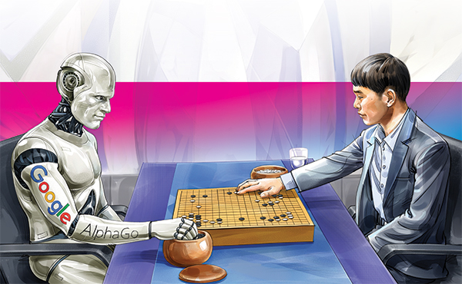
1. Introduction
1. Background of the project
Motivation: Physical operation of AlphaGo (in Gomoku)
Goal
Robot Operation with real-time perception using camera
AI based decision making in game algorithm
2. Expected Results
Getting used to AI with friendly games
Time-killing tools for solitary people

Slide 4
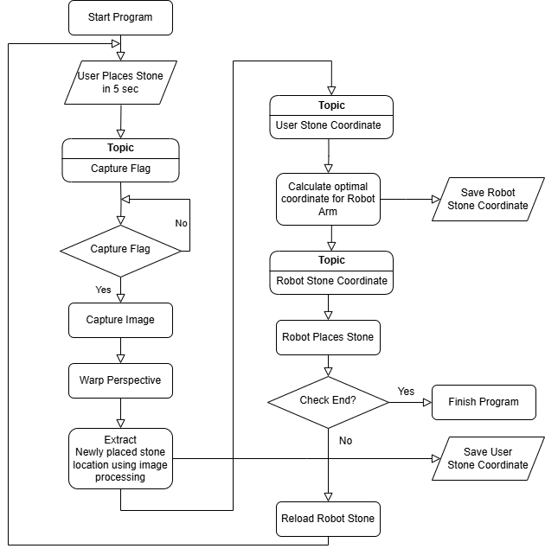
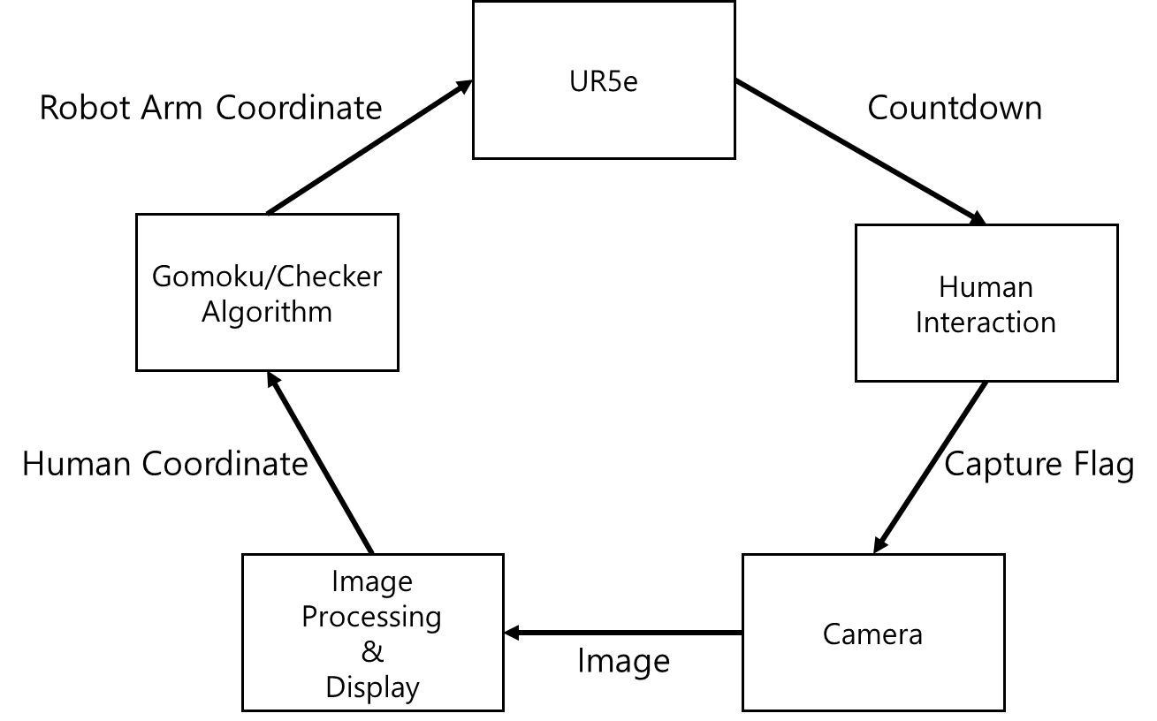
1. Introduction
Development Environment and Hardware
OS: Linux Ubuntu 20.04
ROS Noetic
HW: UR5e Robot, Camera ODROID USB-CAM 720P
Packages: OpenCV, TensorFlow
RQT graph and Flowchart
Simplified RQT graph
Flowchart of our Program

Slide 5
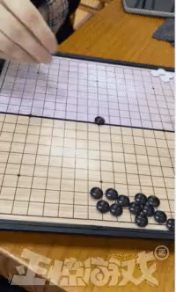
2. Gomoku Game
Instruction to Gomuku Game
Gomoku game
Place five stones in a row
How it works
User always plays first. Place a black stone
Camera detects the user’s stone and calculates the optimal move
Robot arm places a white stone
Features
Don’t hesitate to place stone (It may detect wrong position)
Place stones on the correct grid to avoid recognition errors
https://github.com/DahamChoi/omok

Slide 6
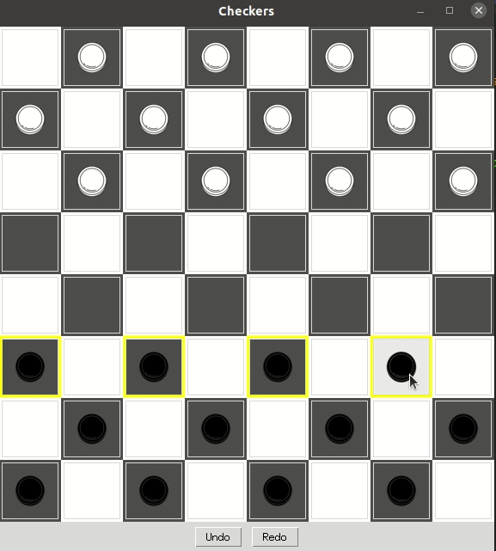
3. Checker Game
Instruction to Checker Game
Checker game
Jumping the opponent’s stones and remove them
How it works
Select for mandatory jump rule
User always plays first. Place a black stone
Camera detects the user’s stone and calculates the optimal move
Robot arm places a white stone
Features
Remove the captured stone manually
Place stones on the center of the compartment to avoid recognition errors

Slide 7
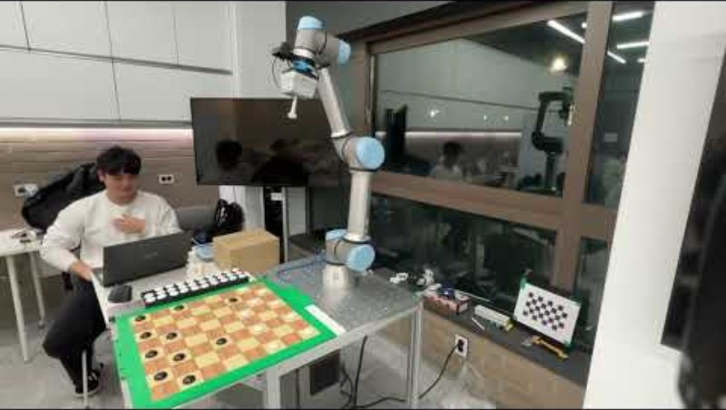
4. Demo Video

Slide 8
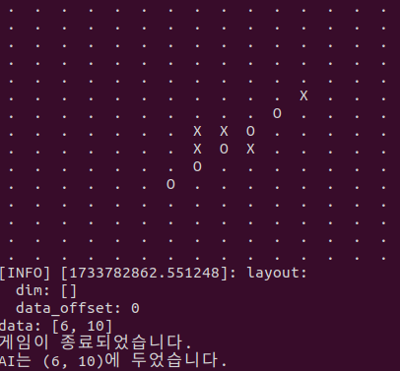
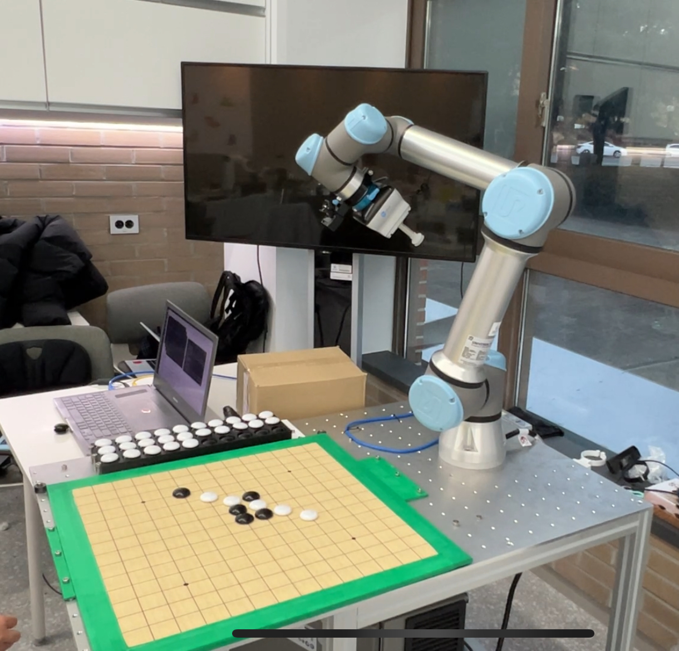
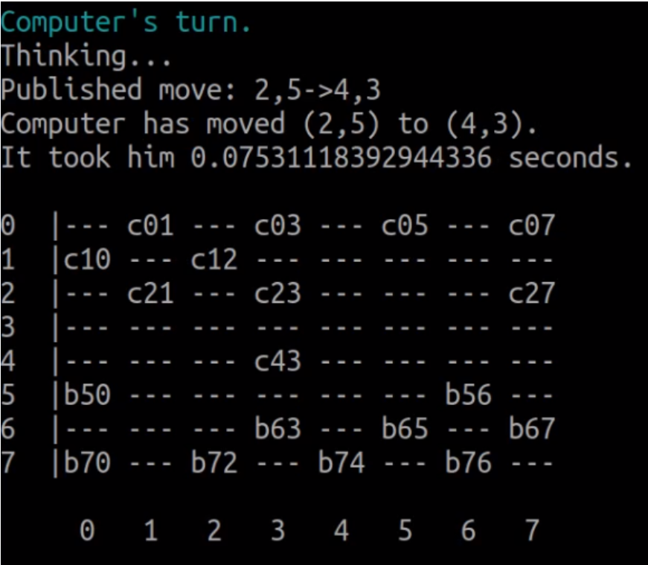
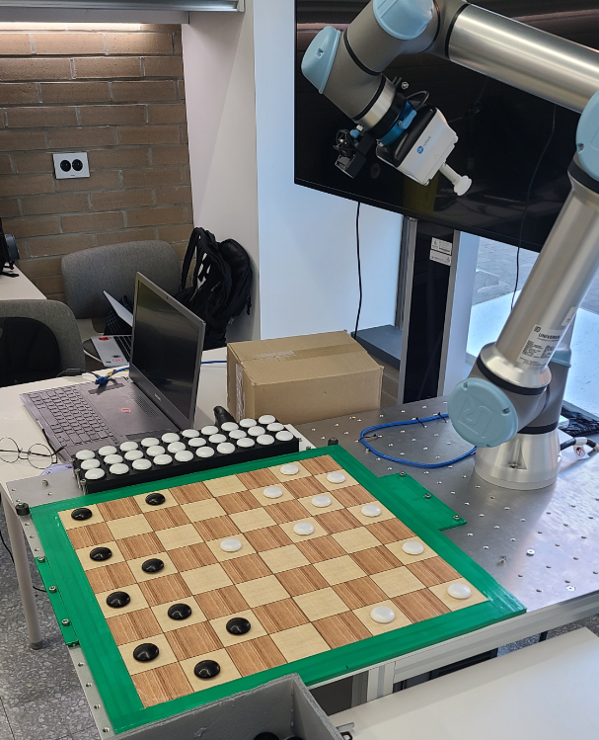
5. Conclusion
Performance of Image Processing
Accuracy of Gomoku Game: 100% position detection
Accuracy of Checker Game : 100% position detection
Performance of AI
Gomoku: 16 Games, 5 wins, 11 losses for A.I. model
Checker: 8 Games, 0 win, 8 losses for A.I. model
Research Conclusion
The project achieved both Real-Time perception and AI-based decision.
Further improvements
Exception Handlers for (After countdown situation, Detection fault case) Gomoku program
Robot abnormal movement prevention

